Slide 1
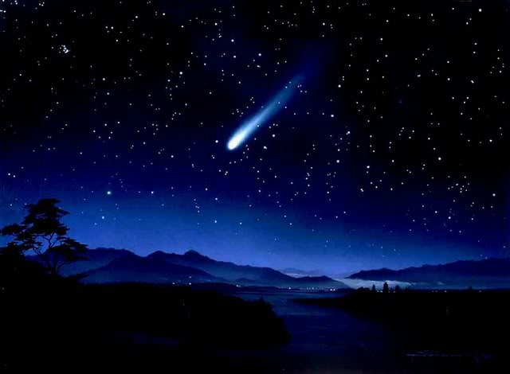
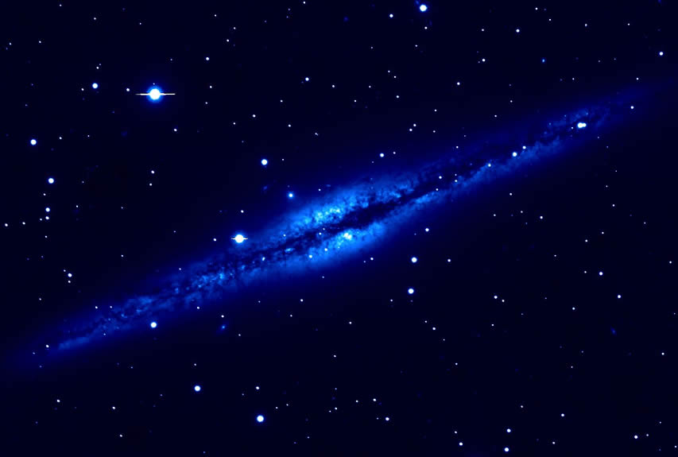
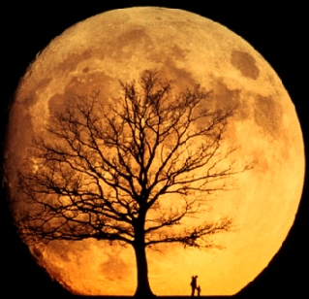
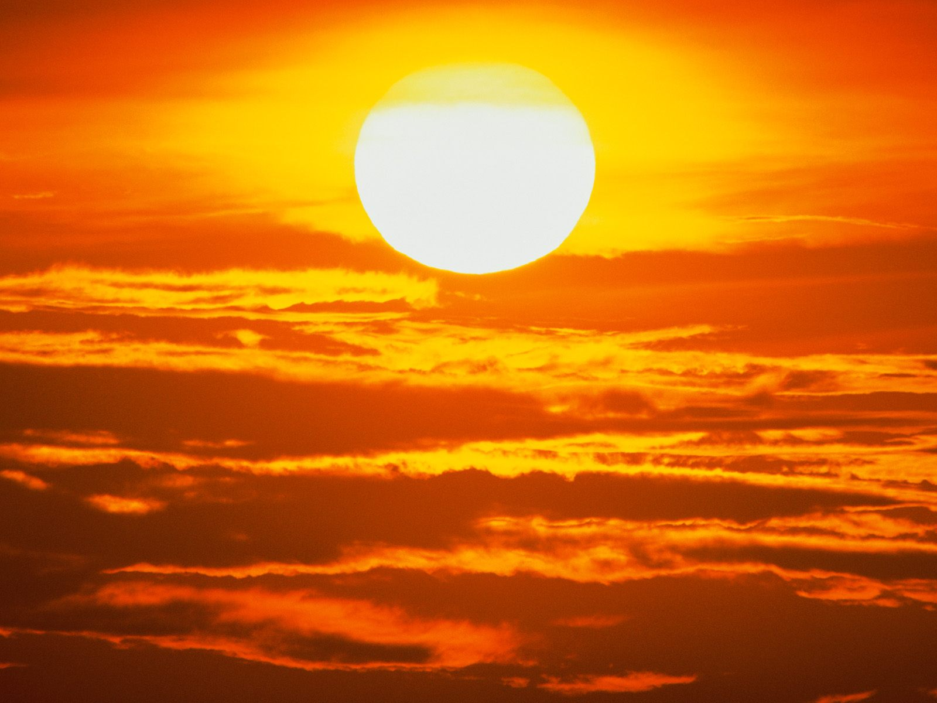
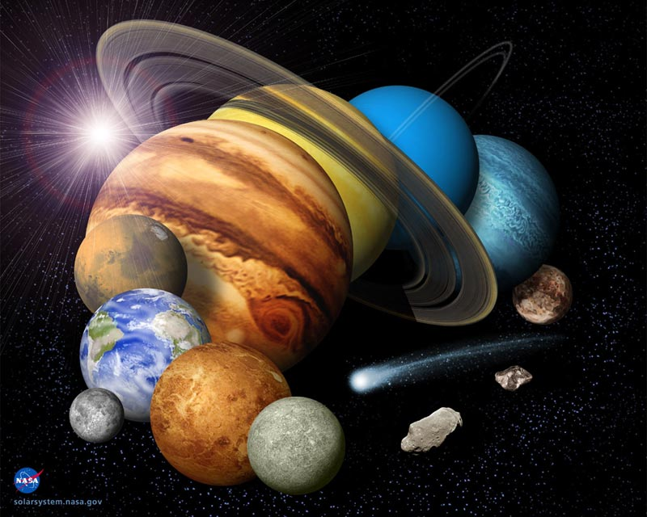
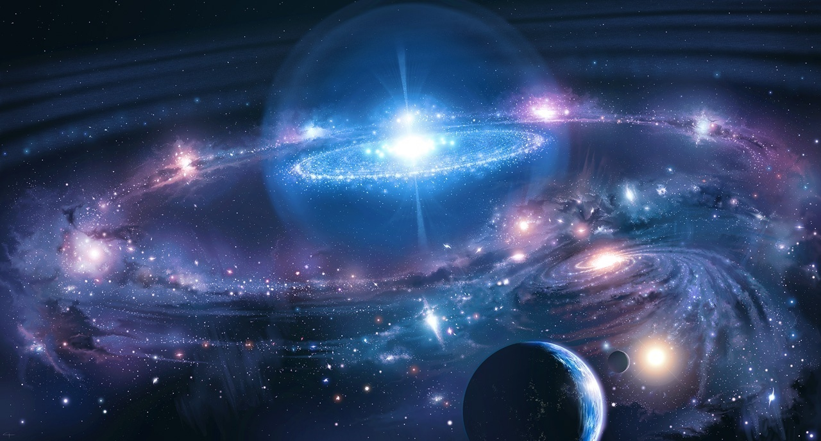

In our shinning universe there are billions of stars , millions of meteors, hundreds of stars , plenty of planets, many moons , a unique sun and many more celestial bodies.
The milky way galaxy
A journey to our milky way galaxy.

Slide 2
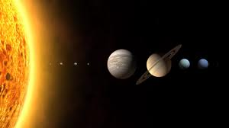

Wonderful SUN
SHINY
HOT
GLOWING
SOURCE OF ENERGY
STAR

Slide 3
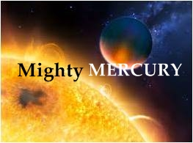
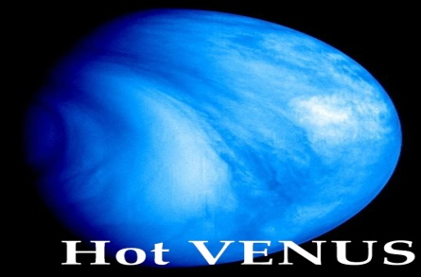
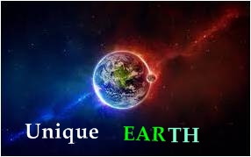
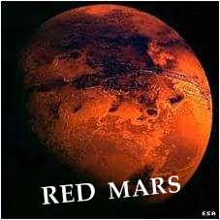
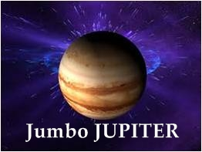
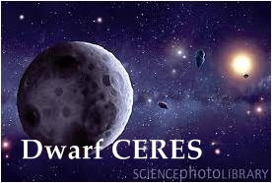
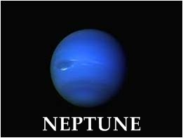
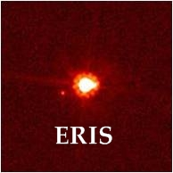
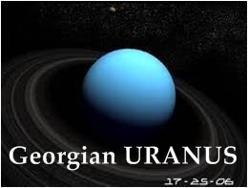
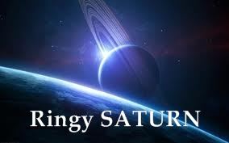

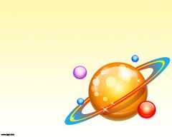
planets
A planet is a celestial body orbiting a star or
Stellar remnant that is massive enough to be rounded By its own gravity .

Slide 4
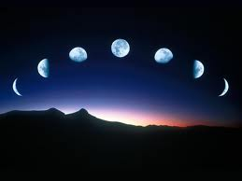
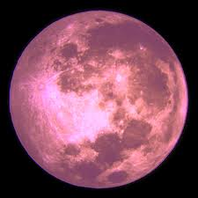
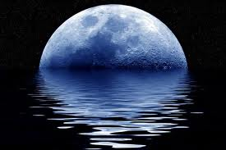
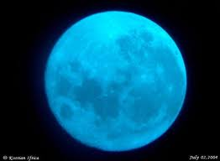
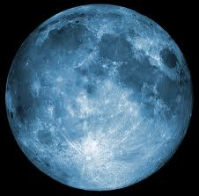
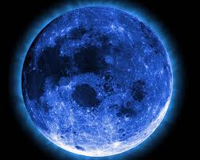
Moon
The Moon is the only natural satellite of the Earth ,and the fifth largest satellite in the solar system. It is the largest natural satellite of a planet in the Solar System

Slide 5
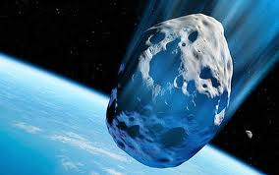
Asteroids or planetoids
Asteroids are a class of small solar system Bodies in orbit around the Sun, they are also called Planetoids.
Facts about Asteroids
ASTEROIDS ARE SMALL SOLID OBJECT THAT ORBIT THE SUN.
THEY ARE SOMETIMES CALLED MINOR PLANETS.
ASTEROIDS HAVE LARGE CRATER ON THEM.
THE REALLY BIG ASTEROIDS HAVE MOON.
THE ASTEROID BELT LOCATED BETWEEN MARS AND JUPITER IS MADE UP OF 5,000 ASTEROIDS.

Slide 6
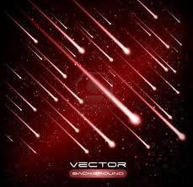
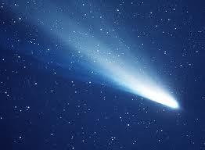
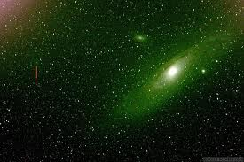
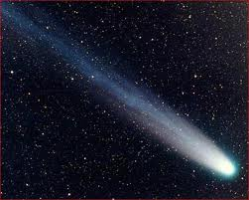
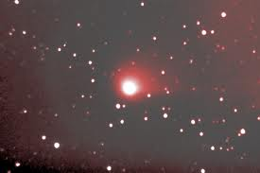
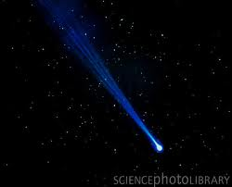
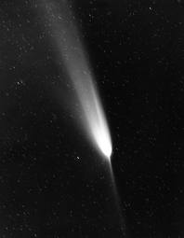
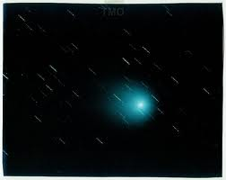
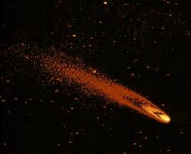
COMETS
A comet is an icy small solar system body
Comets are small, fragile, irregularly shaped bodies composed of a mixture of non-volatile grains and frozen gases.
Halleys comet
Encke comet
Biela comet
Faye comet
Brorsen comet
Arend and Roland
comet
Austin comet
Bennnett comet

Slide 7
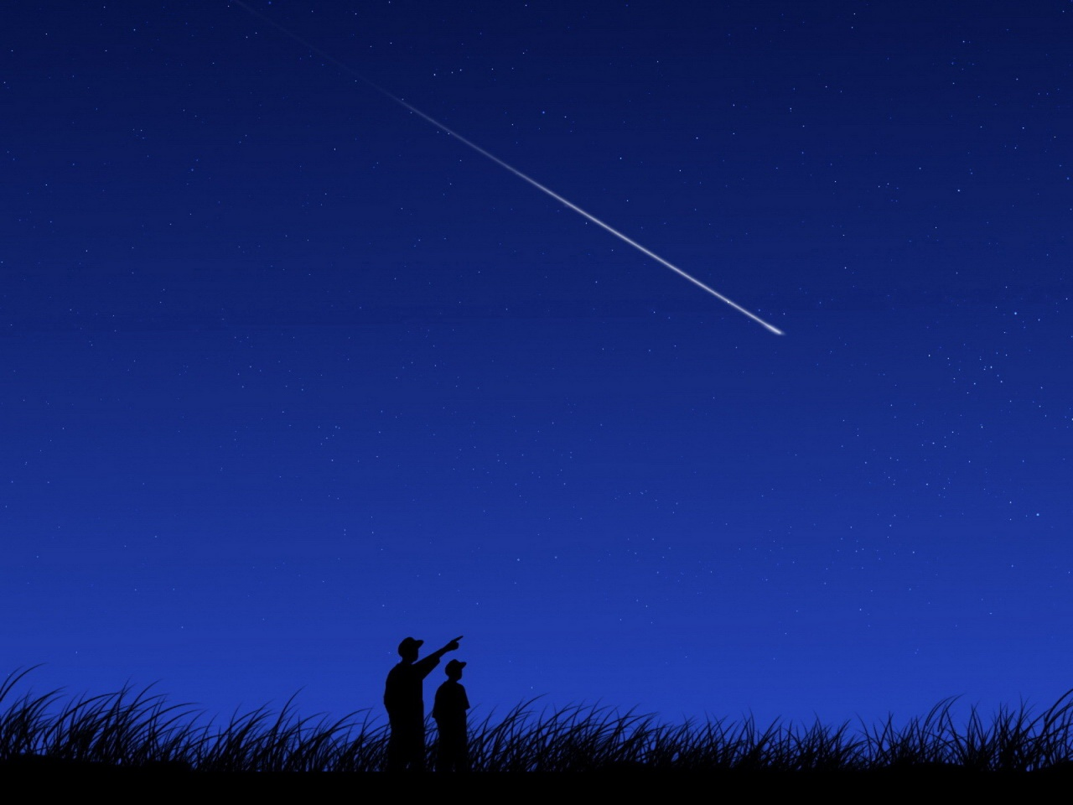
METEOR
A METEORIDE is a sand- to boulder –sized particle of debris in the solar system. The visible path of a meteoroid that enters earth’s atmosphere is called a METEOR, or colloquially a shooting star or falling star.
If a METEOROID reaches the ground and survives impact, then it is called a METEORITE. Many meteors appearing seconds or minutes apart are called A METEOR SHOWER.
A METEOROID is a solid object moving in interplanetary space, of a size considerably smaller than an asteroid and considerably larger than an atom.

Slide 8
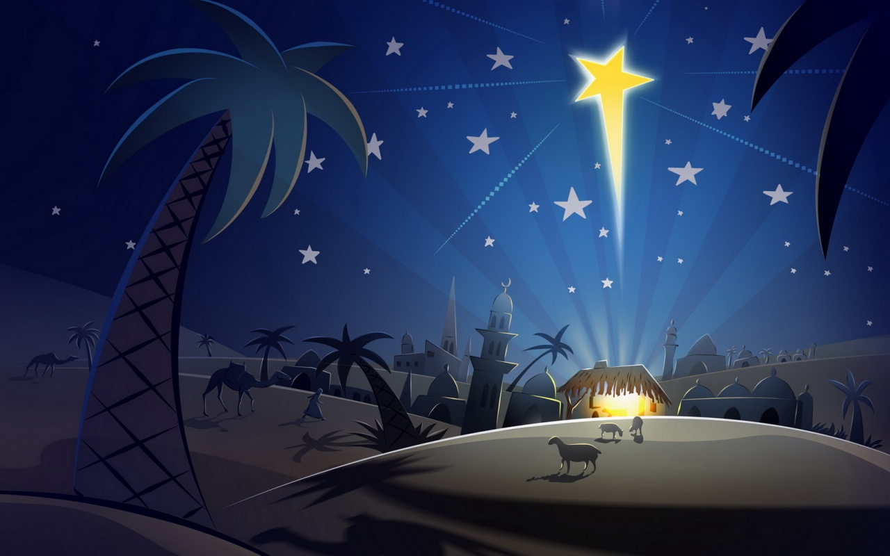
STAR
A star is a massive, luminous sphere of plasma held together by gravity. The nearest star to Earth is the Sun, which is the source of most of the energy on the planet. Other stars are visible from Earth during the night when they are not obscured by atmospheric phenomena, appearing as a multitude of fixed luminous points because of their immense distance.

Slide 9
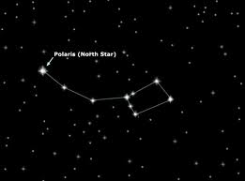
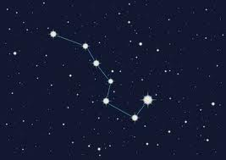
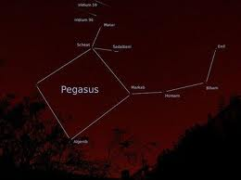
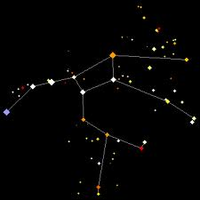
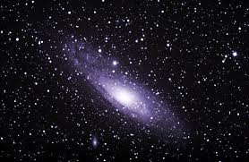

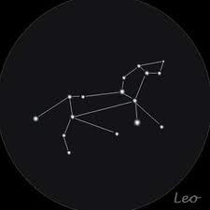
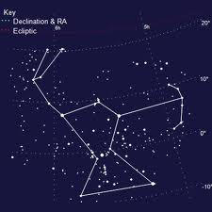
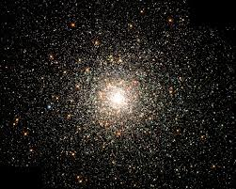
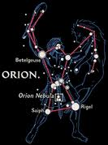
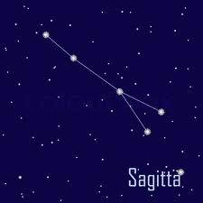
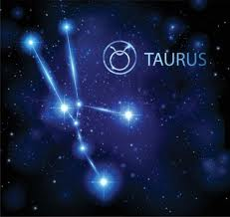
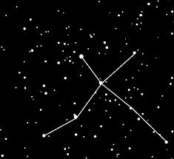
Constellations of star
Constellations of stars
A Constellation is an area of celestial sphere. These areas are grouped around asterisms , which are patterns formed by prominent stars within apparent proximity to one another on Earth's night sky.
Some constellations are:
ORION, TAURUS, CAPRICORNUS, AQUIRIUS, LIBRA, SAGITTA, VIRGO, PISCES, TAURUS, etc……….

Slide 10

MADE BY:
ADITIYA SAINI
SAMARTH AMRIT
SHIVAM SHARMA
AKHIL NAIR

