Slide 1
Science in Medicine

Slide 2
SCIENCE
Science (from Latin scientia, meaning "knowledge") is a systematic enterprise that builds and organizes knowledge in the form of testable explanations and predictions about the universe. In an older and closely related meaning (found, for example, in Aristotle), "science" refers to the body of reliable knowledge itself, of the type that can be logically and rationally explained

Slide 3
Science is helping with advanced and effective antibiotics.
Improvements in technology is providing us with better screening techniques and other diagnostic tools and imaging techniques.
Science and technology have made great contribution in the field of medicine.

Slide 4
MEDICINE
Medicine is the applied science or practice of the diagnosis, treatment, and prevention of disease.It encompasses a variety of health care practices evolved to maintain and restore health by the prevention and treatment of illness in human beings.

Slide 5
Ultrasound
in Medicine

Slide 6
What is Ultrasound?
Ultrasound is simply sound that has a very high frequency.
Humans are not able to hear ultrasound, though some animals can hear them.
Sounds with frequencies above 20 000 hertz are called ultrasounds.

Slide 7
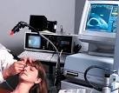
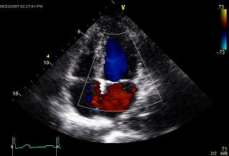
Uses of Ultrasound in Medicine....
Ultra sound is used investigate the internal organs of the human body .
Ultrasound is used in ultrasonography.
Ultrasound is used in echocardiography.
Ultrasound scans are used to monitor the development of fetus .
Ultrasound is used to break kidney stones into fine grains.

Slide 8
Ultrasound used to investigate internal organs…
Ultrasound waves can penetrate the human body and different types of tissues reflect the ultrasound waves in different ways .

Slide 9
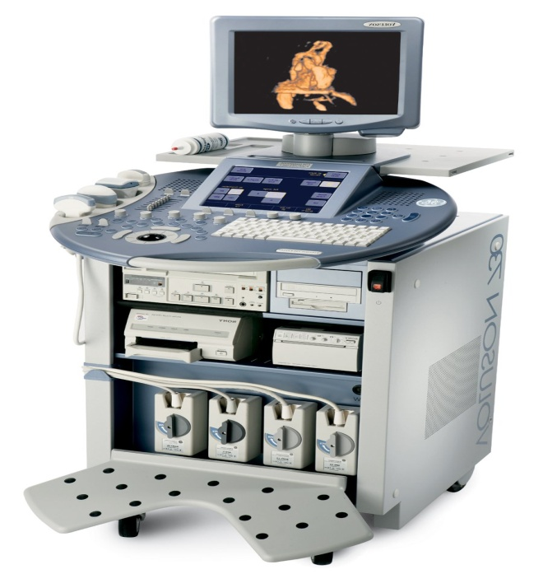
Ultrasonography…
The technique of obtaining pictures of internal organs of the body by using echoes of ultrasound pulses is called ultrasonography ...and such pictures are called ultrasound scans.
A machine which uses ultrasonic waves for obtaining images of the internal organs of human body is called ultrasound scanner …

Slide 10
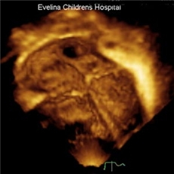
Echocardiography
The use of ultrasound waves to investigate the action of the heart is called ECHOCARDIOGRAPHY …..
Ultrasound is also used for diagnosing heart diseases by detecting the motion of the heart wall, and even scanning the heart from inside .

Slide 11
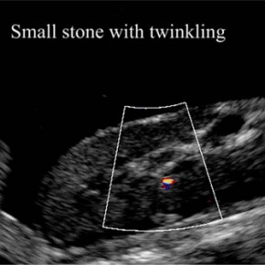
ULTRASOUND USED TO BREAK KIDNEY STONES…..
When high frequency ultrasound waves are directed on the stones on the kidney, the strong ultrasound vibrations shake the stones so much that they ultimately break into fine grains. These fine grains of stones are so small that they pass out from the kidney along with urine.

Slide 12
DEVELOPMENT OF FETUS ...
Ultrasound scans are used to monitor the development of fetus (unborn baby) inside the mother’s uterus ..
The ultrasound scanner transmits ultrasound into the mother’s body and receives echoes formed by the reflection of ultrasound from inside. It is used for the examination of fetus to detect any growth abnormalities……

Slide 13
Why Use Ultrasound?
Ultrasound is very safe. There is no firm evidence that it does any harm to the body (or the baby in the case of pregnancy scans).
X-rays are potentially dangerous, particularly to young children and pregnant women (they damage the unborn baby).

Slide 14
How Does It Work?
Medical ultrasound systems use very high frequencies - several megahertz (mega means million or 10⁶).
A sound is a wave it has all the usual wave properties (reflection, refraction, diffraction). Ultrasound imaging makes use of the fact that sound can be reflected.
The idea is just like that used in radar and sonar.

Slide 15
Thank you……..
Made by :
Yankita
Tanya Arora
Varnisha Kalra
Akansha Manocha

